Slide 1
Window Programming 1-4
A integrated example: ToString, Parse

Slide 2
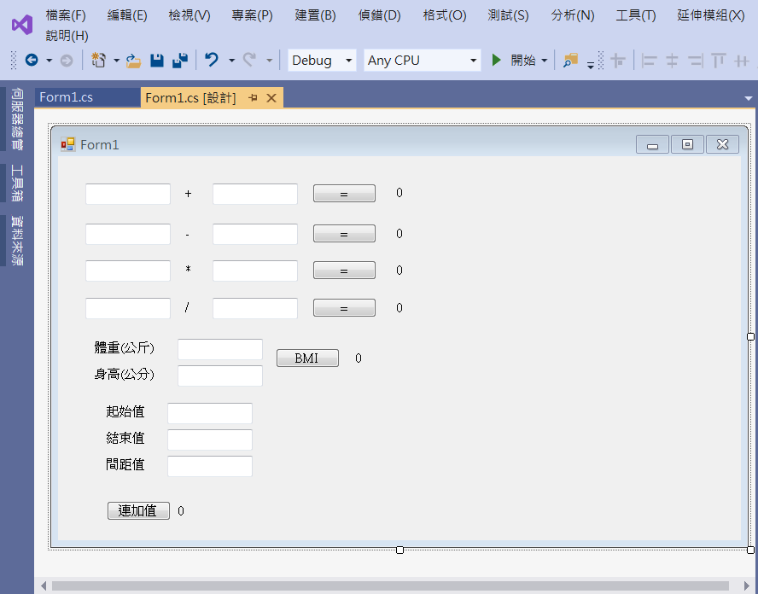
Integrated example
label1
textBox2
button1
textBox1
label2
textBox3
label4
textBox5
label6
textBox7
label8
textBox9
label11
textBox10
textBox11
textBox12
button5
textBox13
label15
button6

Slide 3
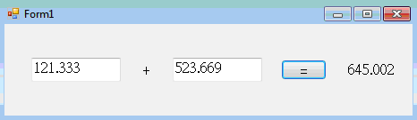
Integrated example
//加法計算
private void Button1_Click(object sender, EventArgs e)
{ double a = double.Parse(textBox1.Text);
double b = double.Parse(textBox2.Text);
double c = a + b;
label2.Text = c.ToString();
}
//減法計算
private void Button2_Click(object sender, EventArgs e)
{ double a = double.Parse(textBox3.Text);
double b = double.Parse(textBox4.Text);
double c = a - b;
label4.Text = c.ToString();
}

Slide 4
Integrated example
//乘法計算
private void Button3_Click(object sender, EventArgs e)
{ double a = double.Parse(textBox5.Text);
double b = double.Parse(textBox6.Text);
double c = a * b;
label6.Text = c.ToString();
}
//除法計算
private void Button4_Click(object sender, EventArgs e)
{ double a = double.Parse(textBox7.Text);
double b = double.Parse(textBox8.Text);
double c = a / b;
label8.Text = c.ToString();
}

Slide 5

Integrated example
//BMI值計算
private void Button5_Click(object sender, EventArgs e)
{ double w = double.Parse(textBox9.Text);
double h = double.Parse(textBox10.Text);
h /= 100; //公分轉為公尺單位
double bmi = w / Math.Pow(h, 2);
label11.Text = bmi.ToString();
}

Slide 6
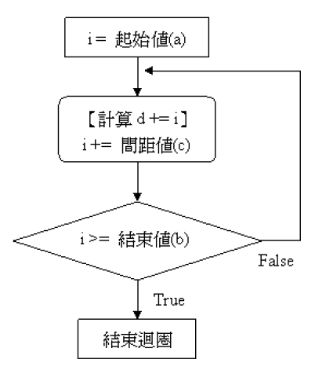
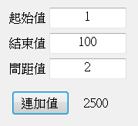
Integrated example
//連加法
private void Button6_Click(object sender, EventArgs e)
{
double a = double.Parse(textBox11.Text);
double b = double.Parse(textBox12.Text);
double c = double.Parse(textBox13.Text);
double d = 0;
for (double i = a; i <= b; i += c)
{
d += i;
}
label15.Text = d.ToString();
}

Slide 7
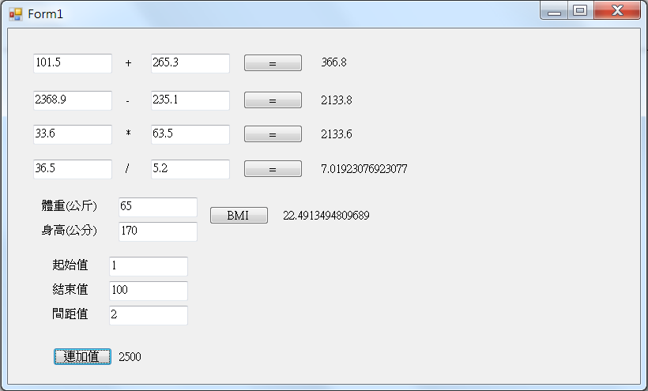
Exercise#1-4

